Slide 1
UNIT-IV SYLLABUS Functions: Introduction – using functions – Function declaration/ prototype – Function definition – function call – return statement – Passing parameters – Scope of variables – Storage Classes – Recursive functions. Structure, Union, and Enumerated Data Types: Introduction – Nested Structures – Arrays of Structures – Structures and Functions– Union – Arrays of Unions Variables – Unions inside Structures – Enumerated Data Types.

Slide 2
PARAMETER PASSING
The values are passed to the function through the arguments. In C language we can pass values from calling program/function to called program/function in two types.
1. Call by value
2. Call by reference

Slide 3
CALL BY VALUE:
In call by value mechanism the values of actual arguments at the function call are copied into the formal arguments of the function definition. After manipulations in the function definitions changes done in formal arguments will not affect the actual arguments.

Slide 4
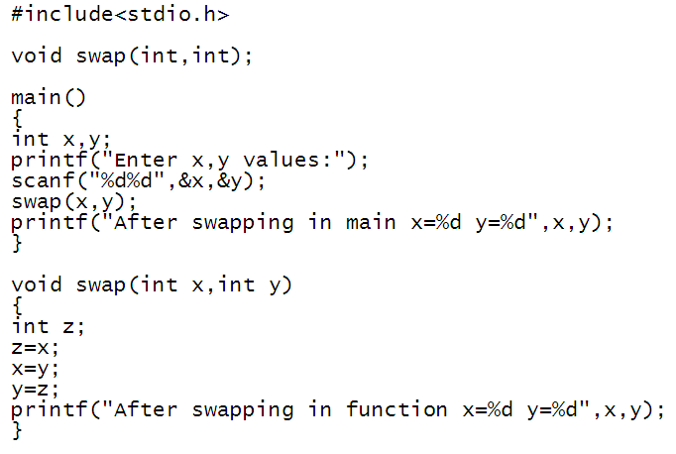
Example:

Slide 5
CALL BY REFERENCE:
BY REFERENCE: In this mechanism instead of sending argument values to function definition, address of actual arguments will be send. The changes made in the formal arguments will affect on actual arguments.

Slide 6
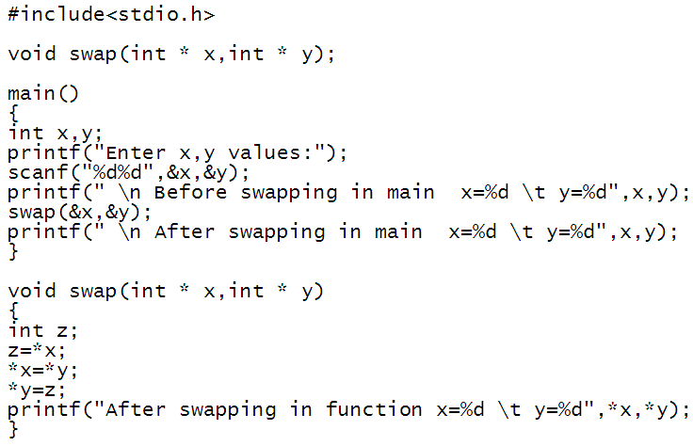
Example:

Slide 7
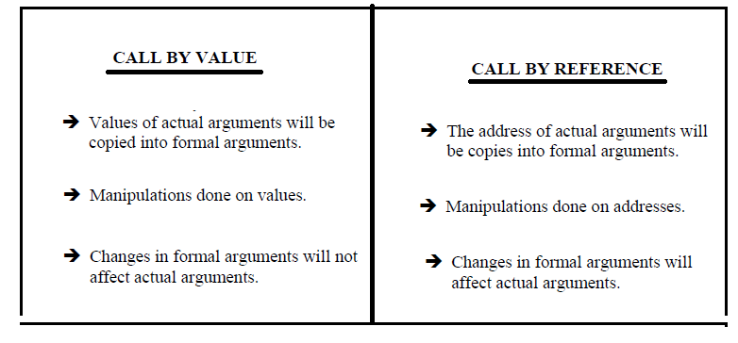
DIFFERENCES BETWEEN CALL BY VALUE AND CALL BY REFERENCE

Slide 8
RECURSIVE FUNCTION:
1. A function which calls itself is called as recursive function.
2. It is the process of calling a function by itself, until some condition is satisfied.
3. It is used for repetitive computations in which each action is stated in terms of previous results.
4. A recursion procedure has to satisfy the following conditions.
a. A recursive function should have a specific condition
b. Changes must be made in the argument values passed to the function

Slide 9
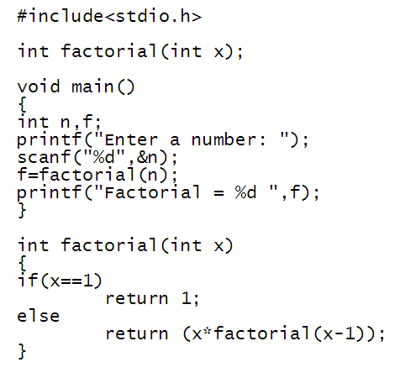
Example:

Slide 10
STORAGE CLASSES:
A storage class defines the scope (visibility) and life-time of variables and/or functions within a C Program.
They precede the type that they modify.
The following are the storage classes in C.
Automatic storage class
Register storage class
Static storage class
External storage class

Slide 11
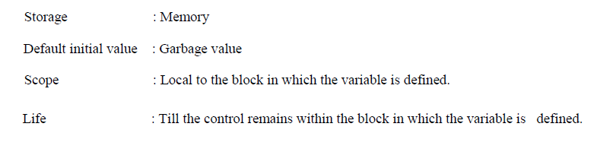
AUTOMATIC STORAGE CLASS-(auto)
The auto storage class is the default storage class for all local variables.

Slide 12
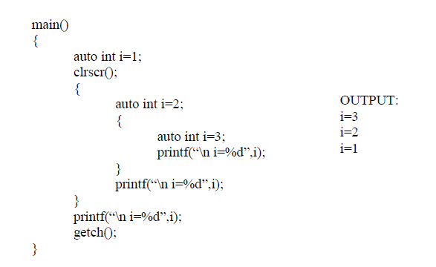
Example

